Slide 1
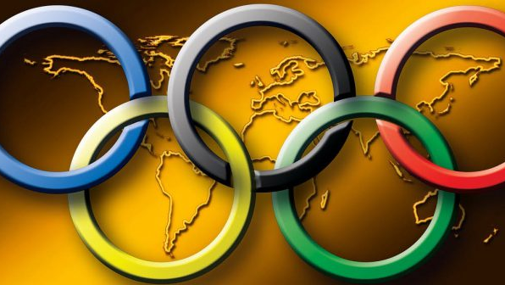
The Olympic Games
Higher, faster further

Slide 2
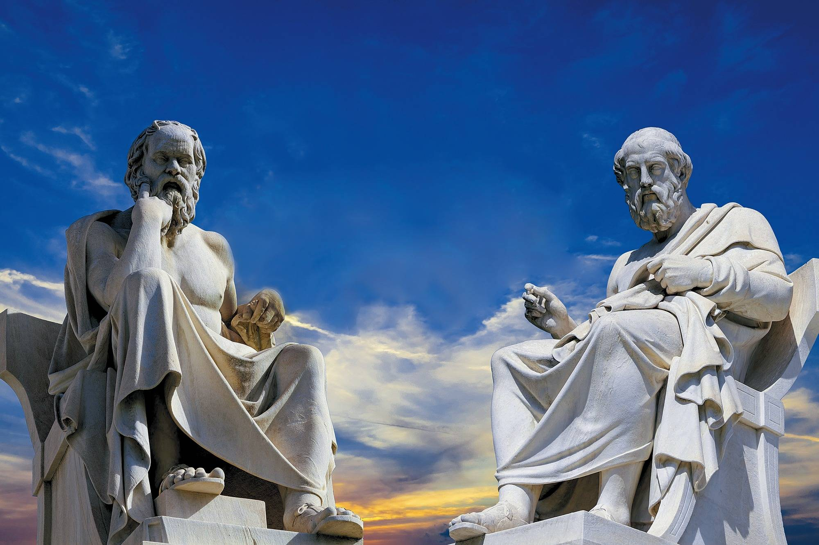
The old Olympic Games
The Olympic Games where invented by the old greeks.

Slide 3
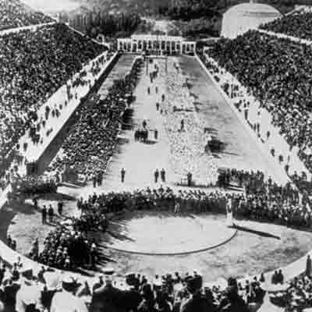
The first olympic sports.
The first olympic sport was a normal race trough the stadium. There where more and more untill 700 BC, there where 18 sports.

Slide 4
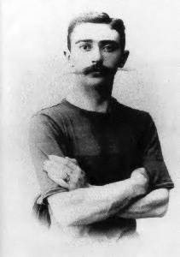
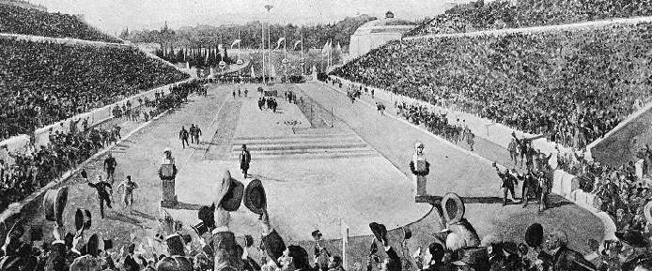
The new Olympic Games
The new olympic games where founded by Pierre de Coubertin at the 23. June 1894

Slide 5

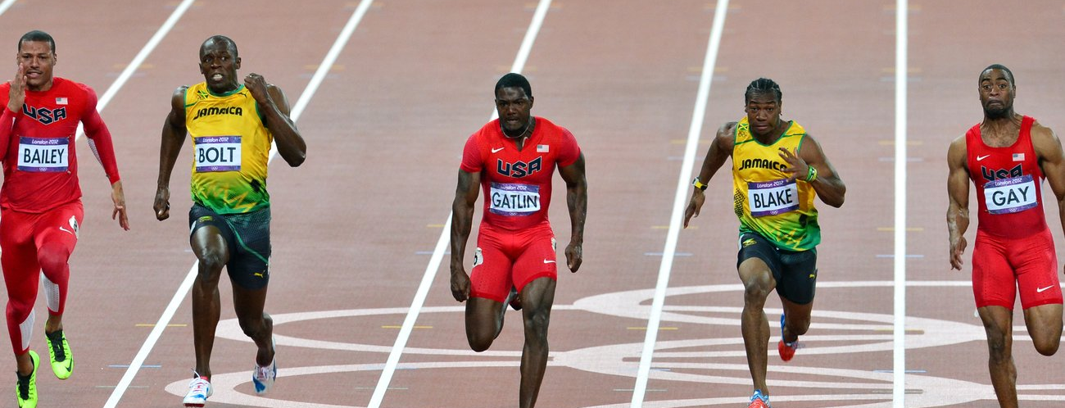
The Olympic Sports
The Olympic games included 35 sports. 28 of them are summer games. The remaining 7 are winter games.

Slide 6

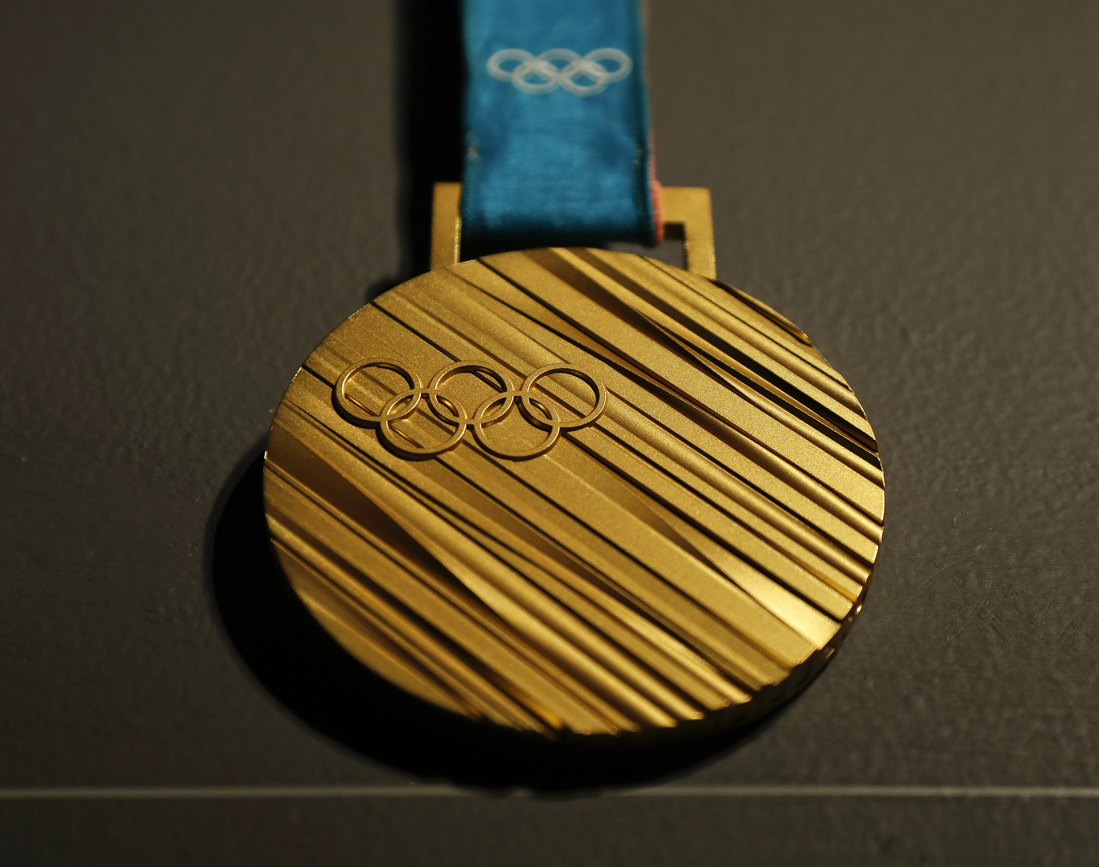
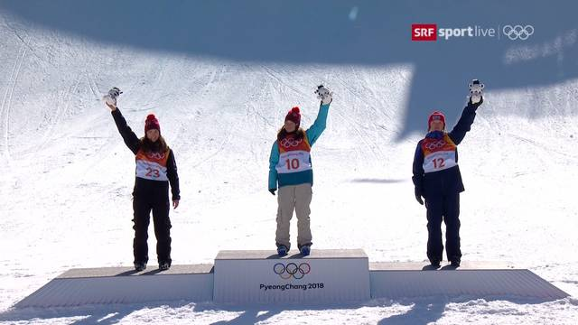
What can you win in the Olympic games?
Old Olympic games:
A palm wreath
Free food in Restaurants
New Olympic games:
A golden Medall
15000 – 20000 Euro

Slide 7
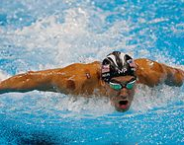
The most sucsessfull atlethe participated in an Olympiad
Michael Phelps 23 3 2 USA
Larissa Lathynina 9 5 4 Soviet Union
Paavo Nurmi 9 3 4 Finnland
Mark Spitz 9 1 1 USA
Carl Lewis 9 1 0 USA

Slide 8
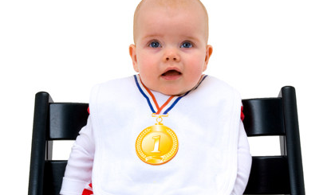
Thanks for listening
I hope you enjoied my presentation
☺

Slide 9

"Dieses Foto" von Unbekannter Autor ist lizenziert gemäß CC BY-SA

